Slide 1
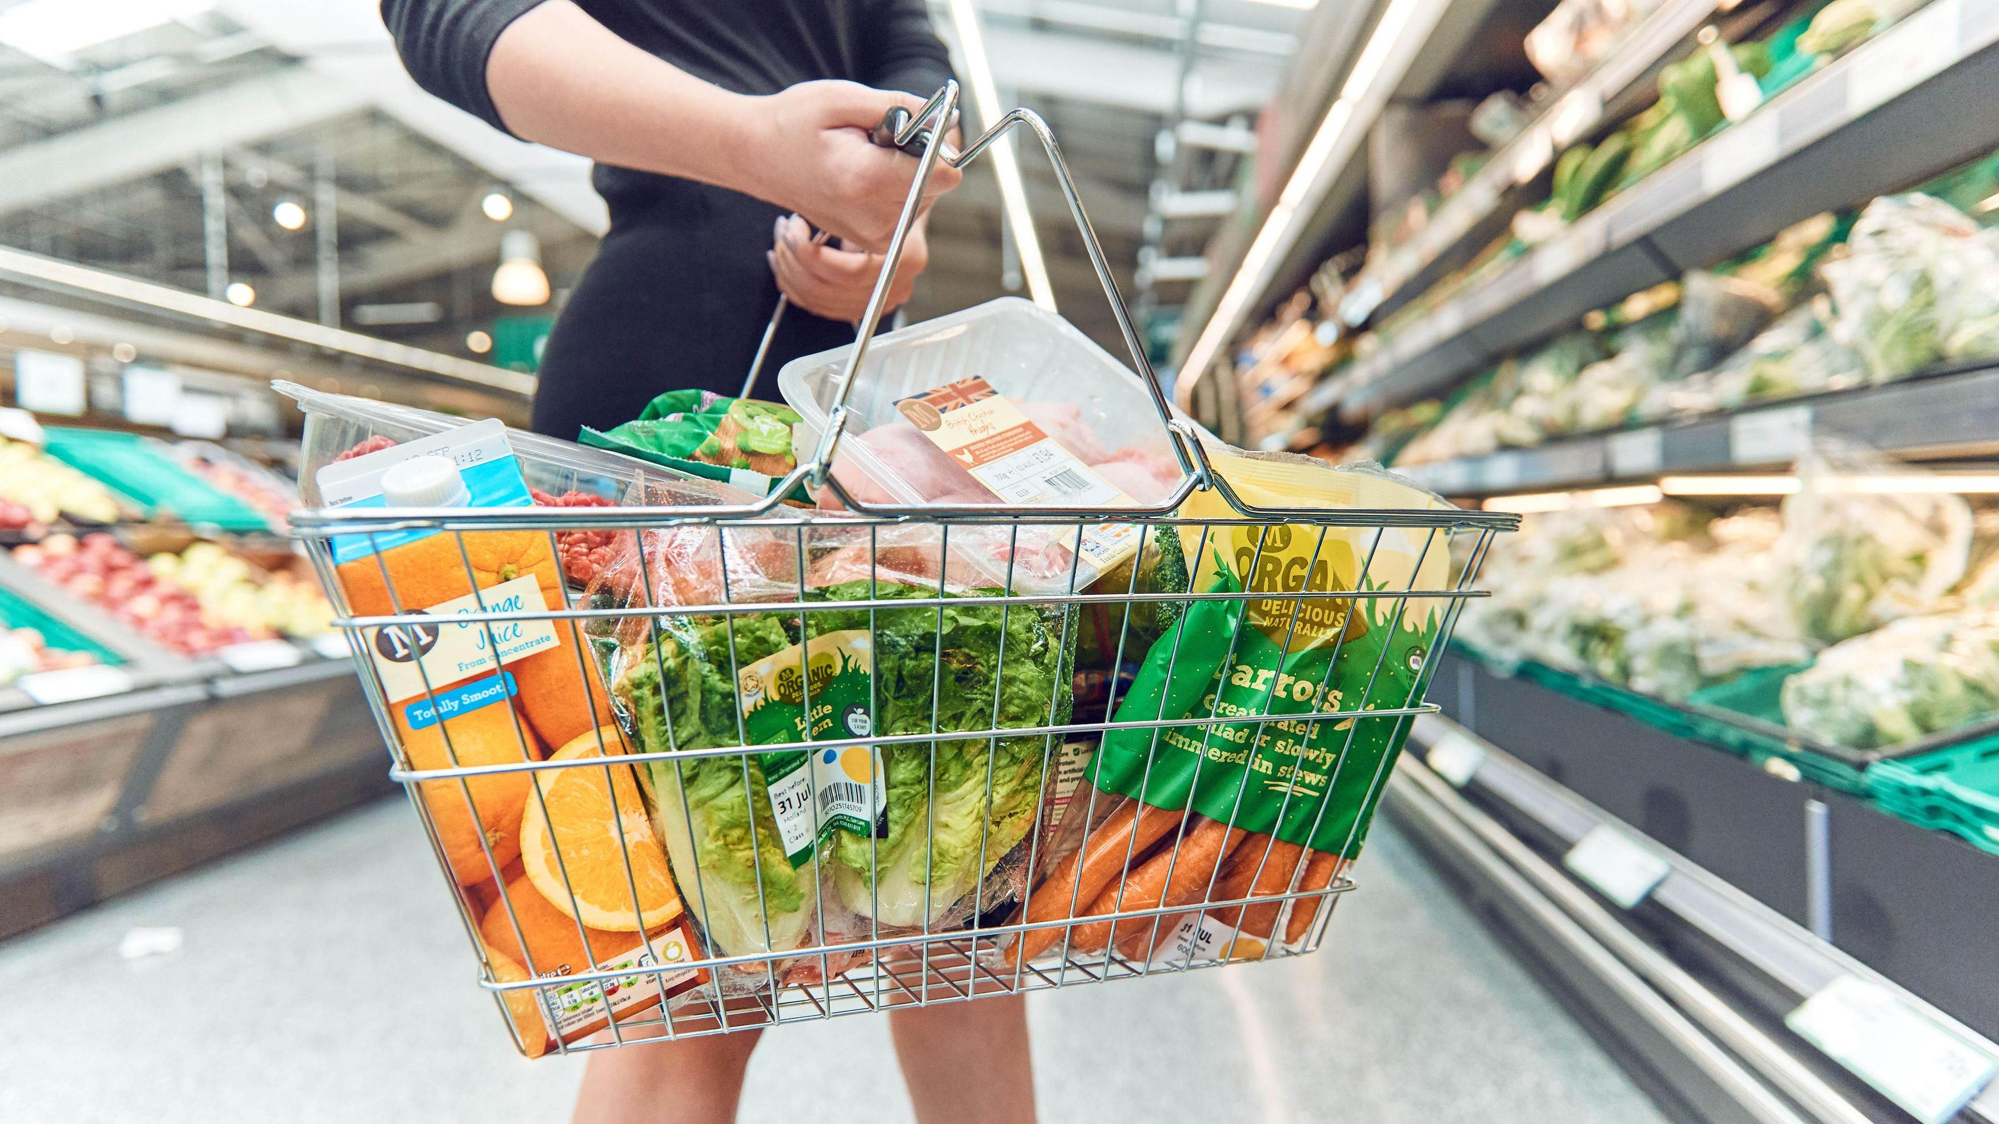
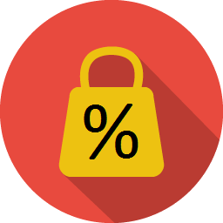
Mobile Application for
Price Sharing & Comparison
Jeanelle Chek Wan Ting (U1620736G)
Project No: SCSE18-0371
Notes:
Searching for bargains can be exhausting. Many of us spend hours on the internet researching for bargains trying to figure out the pricing system which seems random. Prices of goods seems to fluctuate inconsistently and the reason behind this, is dynamic pricing. Good afternoon professors, I am Jeanelle. Today, I’ll be talking about my fyp, mobile application for price sharing and comparison.

Slide 2
Introduction
Supervisor: Dr Sun Aixin
Examiner: Dr Zhang Hanwang
Continuation of the previous
student’s work

Slide 3
Agenda
1
Introduction
2
Implementations
3
Demo
4
Conclusions
Notes:
The agenda for today is as follows.
First, I’ll give a short introduction of the project, followed the implementations and a short demo.
Last but not least, I’ll end off the presentation with a conclusion.

Slide 4
Introduction
1

Slide 5
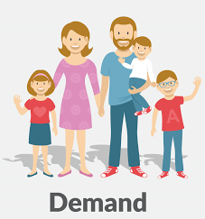
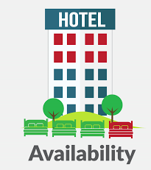
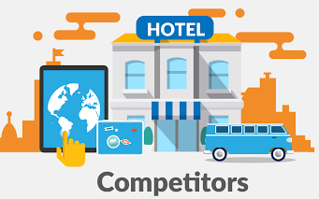
What is dynamic pricing?
“
“
Notes:
I mentioned the term dynamic pricing at the very beginning of the presentation.
So, what is dynamic pricing?
Dynamic pricing is a pricing system which reflects the changing market conditions.
Factors such as demand, availability and competitors affects the price of goods and services.
A higher price reflects a higher demand, limited availability and less competition among competitors.

Slide 6
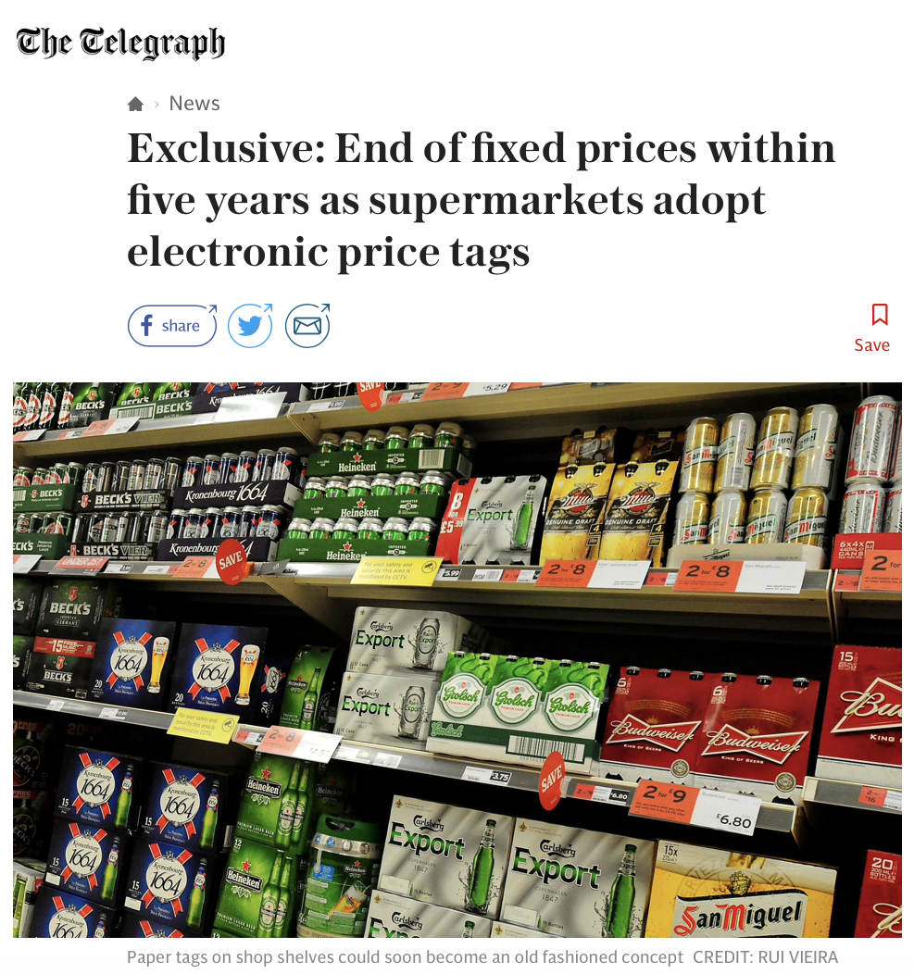
“
"Peak time" pricing where the cost of items rises and falls according to demand is set to become commonplace in supermarkets, at petrol stations and on energy bills.
“
- Katie Morley, consumer affairs editor
24 JUNE 2017
Reproduced from http://telegraph.co.uk/
Notes:
So, where is dynamic pricing adopted?
According to an article from telegraph, several supermarkets in the UK have adopted the electronic price tags. To facilitate the altering of prices, these electronic tags are linked to the shops’ computer system which can alter the prices during the day instead of the traditional paper price tags.
Quoted from the article, (Read from quote).

Slide 7
How do I track prices for the best bargain?
Price
Based on demands, availability and competition
Time
Prices change constantly
Notes:
We know that prices are based on demands, availability and competition.
And that prices change constantly.
So what is the problem ?
How does one track prices for the best bargain?

Slide 8
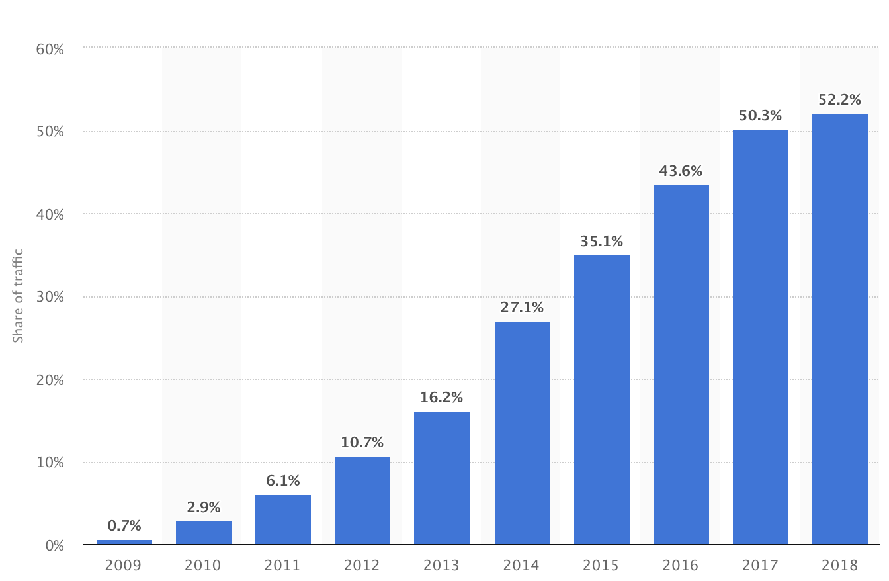
Why mobile?
Increasing website traffic generated from smartphones
More people are relying on smartphones
(2013-2014)
Reproduced from https://www.statista.com

Slide 9
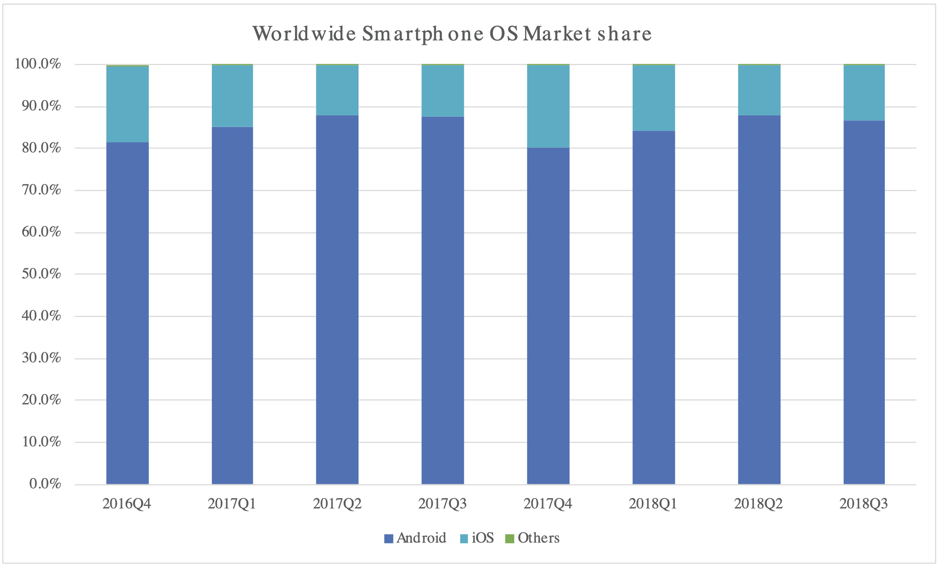
Why android?
Largest market share
=
Allow access to more potential users
“
"Peak time" pricing where the cost of items rises
and falls according to demand is set to become
commonplace in supermarkets, at petrol stations
and on energy bills.
“
Reproduced from https://www.idc.com

Slide 10

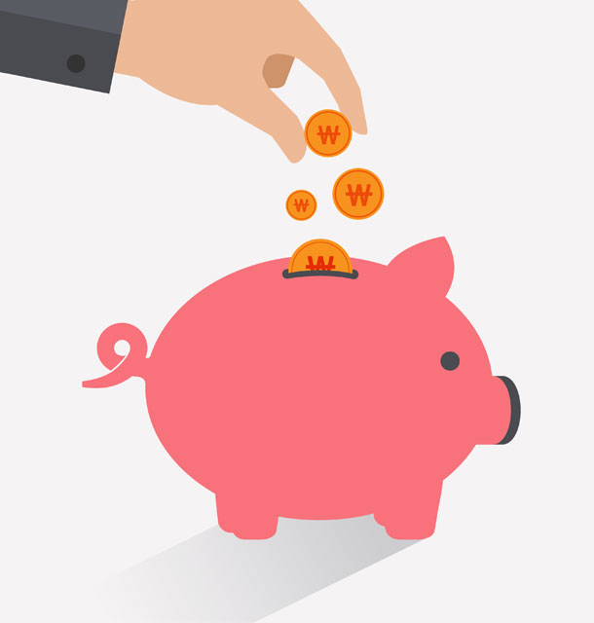
Objectives
Allow users to share and compare prices
Help shoppers save money

Slide 11
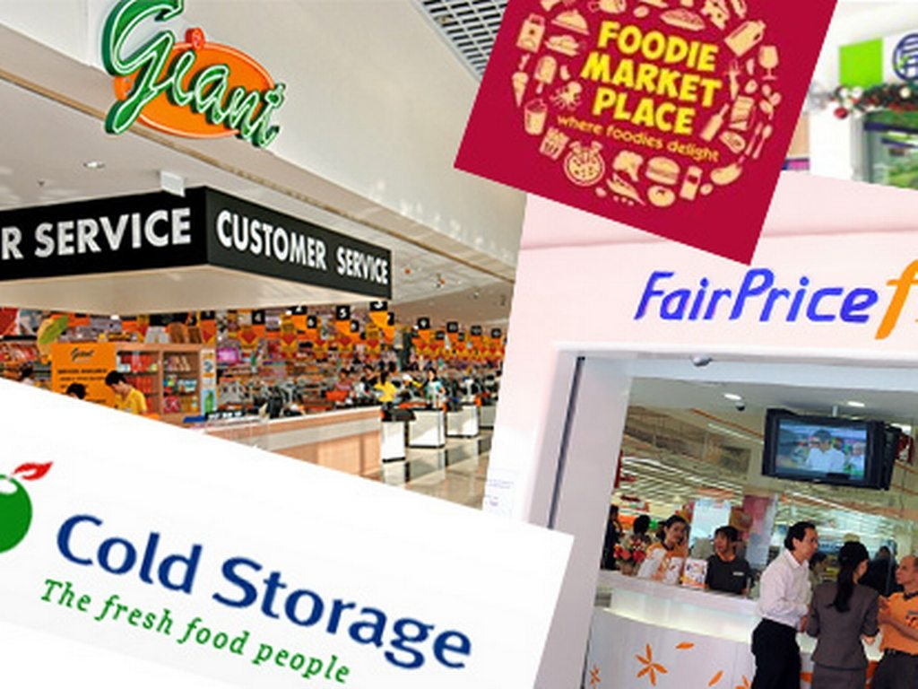


Scope
Restricted to supermarkets
in Singapore
Enhance existing user interfaces and functionalities
Implement new functionalities

Slide 12





Tools
Android Studio
Node.js
PostgreSQL
Amazon Web Service

Slide 13
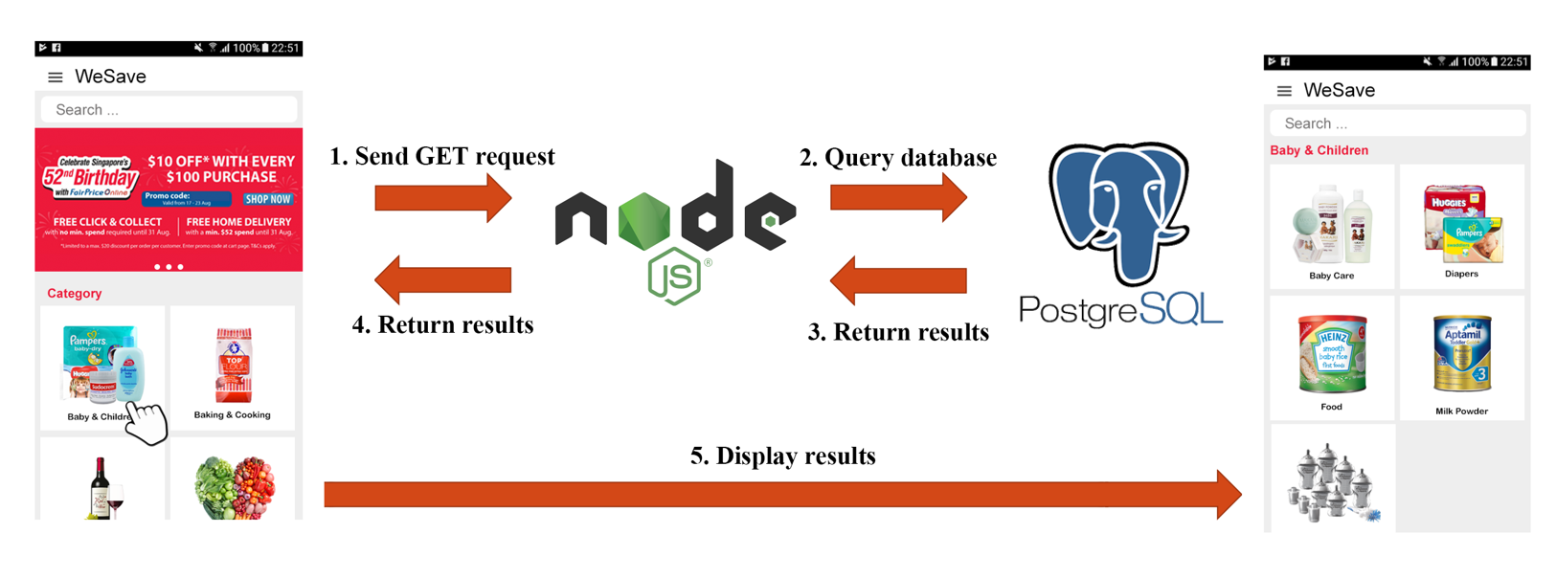
REST Architecture
Notes:
In this project, the REST architecture is used to provide standards between systems and to allow systems to communicate with each other. They are stateless and separate the concerns of client and server. REST requires the client to make a request. There are 4 types of HTTP request. Namely, GET, POST, PUT and DELETE. The get request is used to retrieve data, post is used to create a resource, put is used for update and delete is used to remove a resource.

Slide 14
UAT results
Stops unnecessarily at create item and viewing of shopping item
Can include more icons to make it user-friendly
To avoid confusing the user, the first page after login should not be a barcode scanner.
Username displayed under profile should be email or username of choice
Items and text are not standardised
Feedback section should not require the user to login again
Probably can add recommended items

Slide 15
Implementation
2

Slide 16
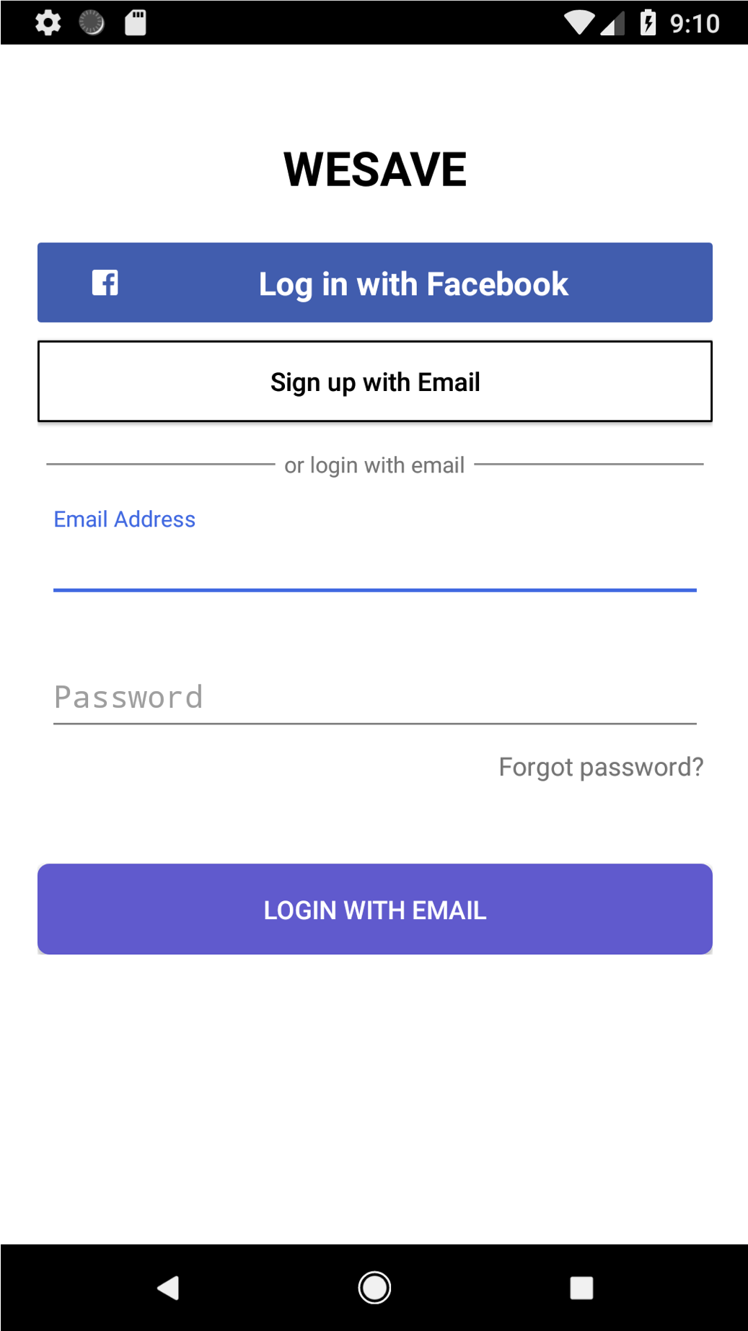
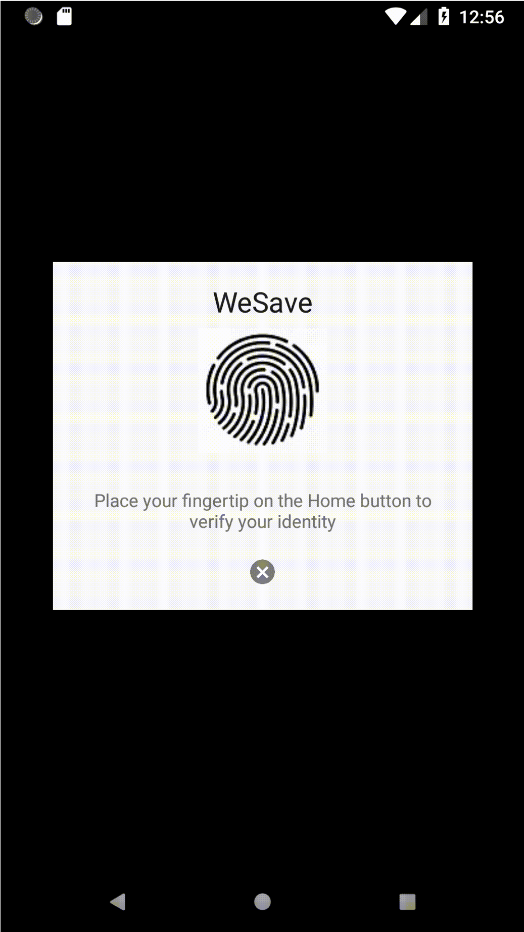
Existing
Enhanced
New authentication method
Fingerprint login

Slide 17
Existing
Enhanced
Changed landing page
after login

Slide 18
Existing
Enhanced
Search items by
Popularity
Keyword
Distance

Slide 19
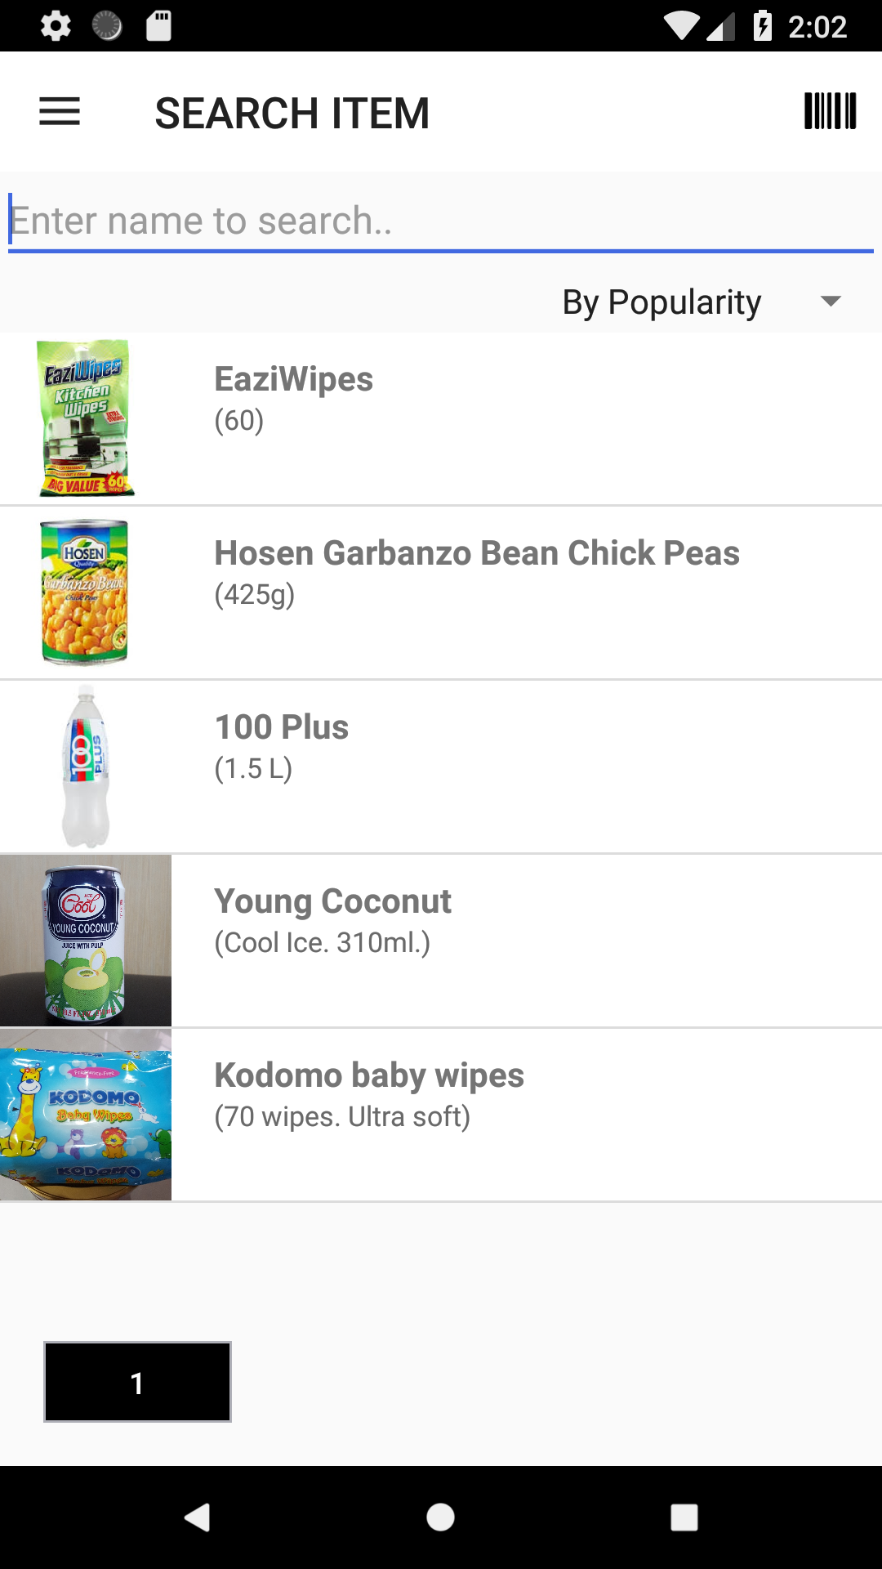
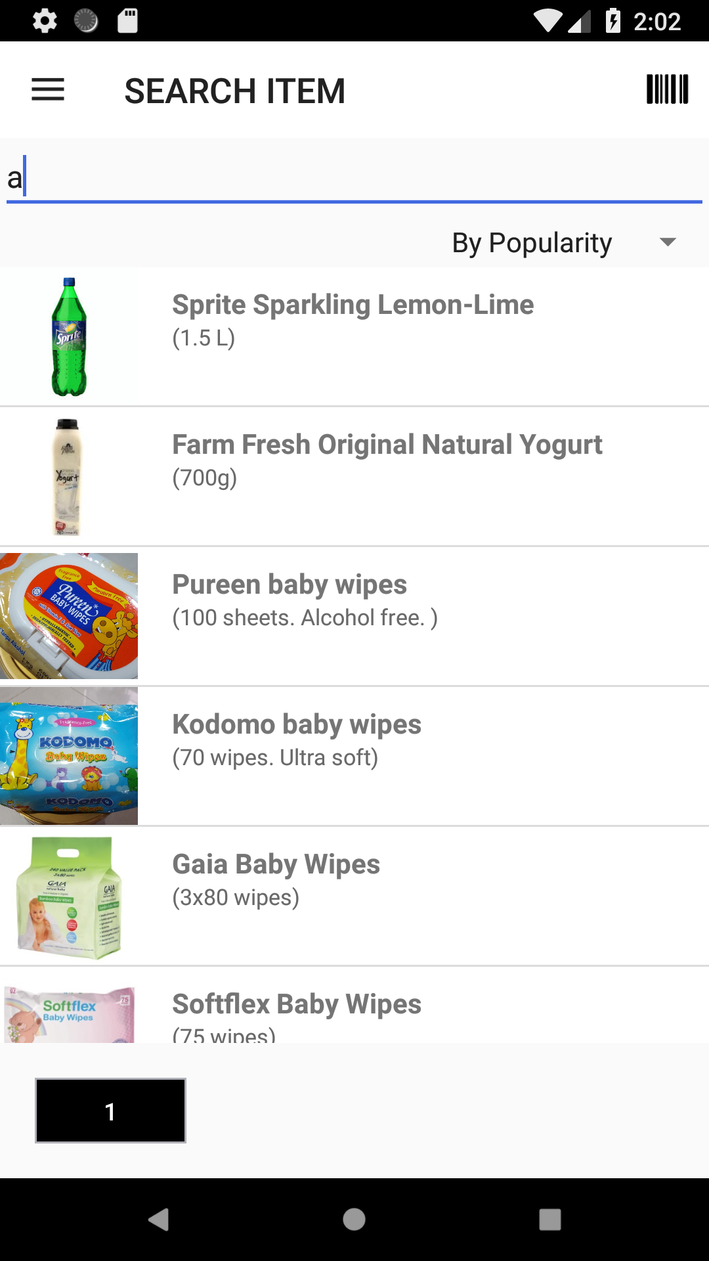
Search items by popularity
Defined as top 5 most followed items
Popular items that contains part of the keyword

Slide 20
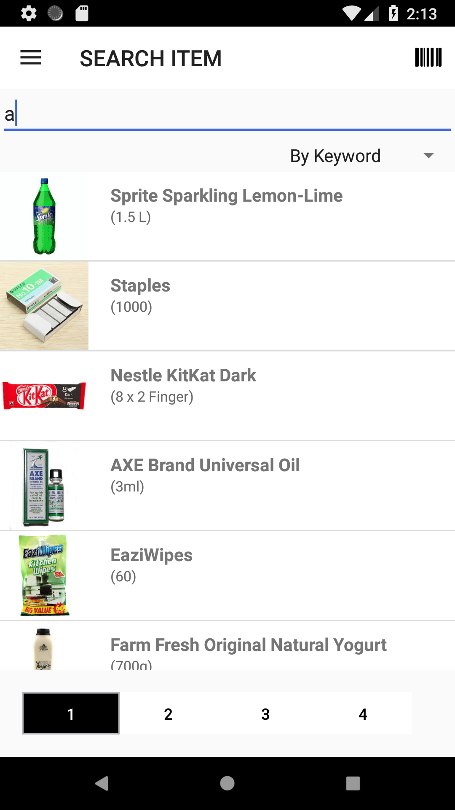
Search items by keyword
Part of item name that contains the keyword

Slide 21
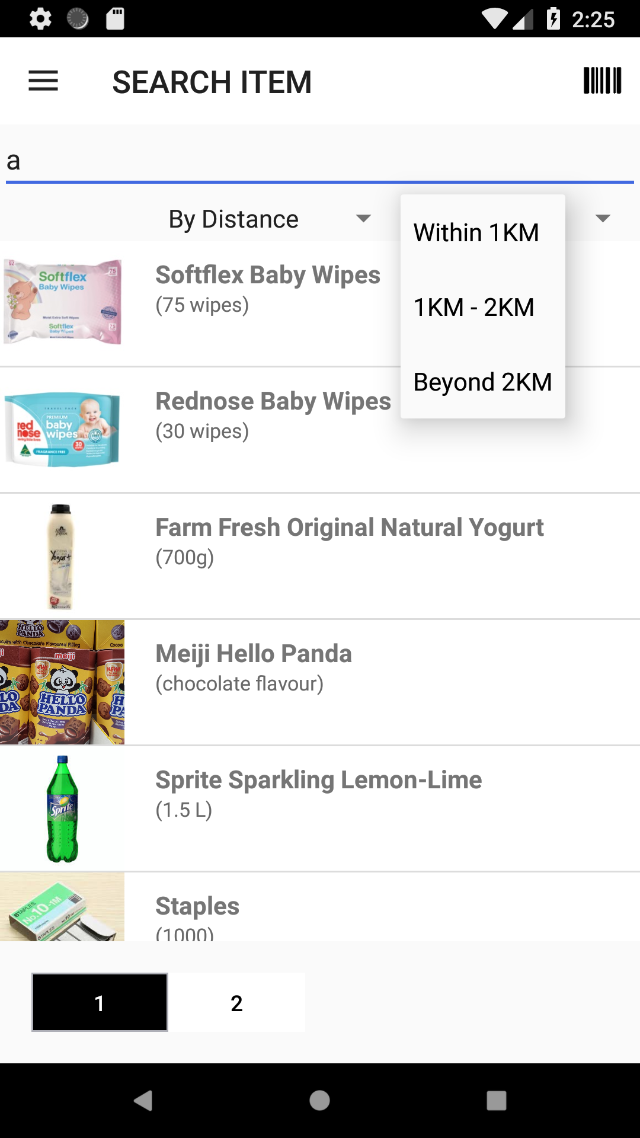
Search items by distance
Within 1km
1km - 2km
Beyond 2km

Slide 22
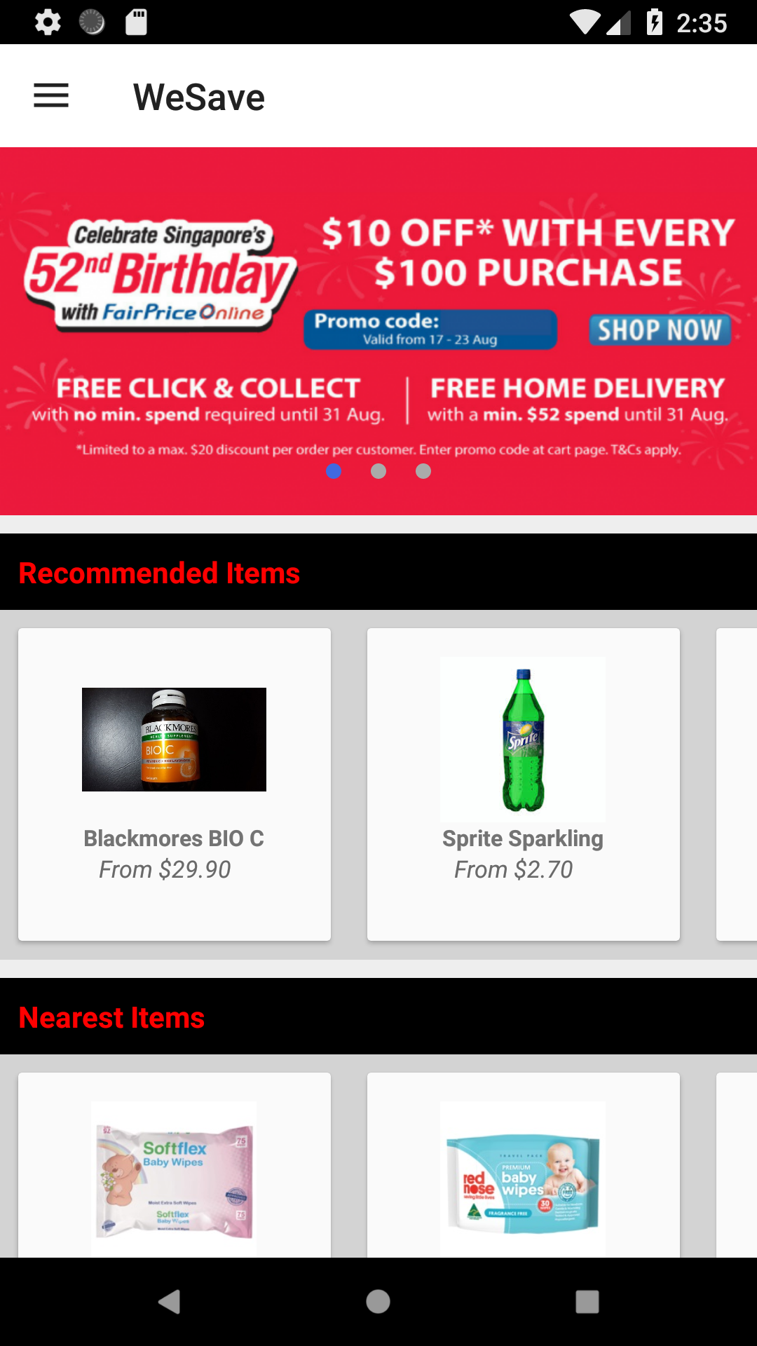
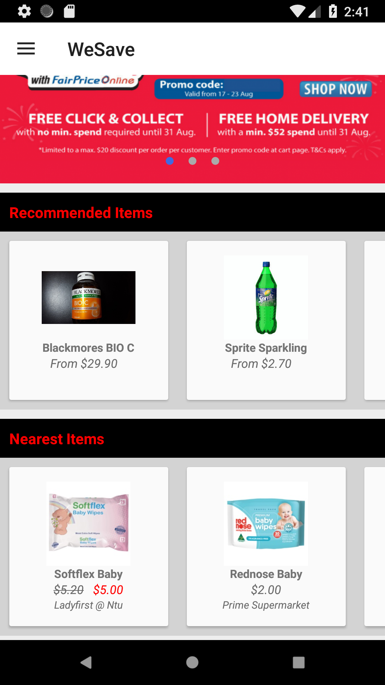
Recommended and nearest items
Recommended Items
Defined as items on promotion
Nearest Items
Based on the user’s location

Slide 23
Minor enhancements
Pagination
Ensure application do not stop halfway
Standardizing text
Adding more icons

Slide 24
Demo
3

Slide 25
Conclusion
Allow shoppers to find bargains efficiently
Successfully implemented and improved application
Skills learnt will aid me with my future career

Slide 26
Q&A

